Slide 1
UNIFIED MENTOR

Slide 2
Projects
Basic Calculator
Personal Portfolio Website
Todo List
Image Slider
Clinic Management System
Gym Management System

Slide 3
Basic Calculator(Basic Project)
Introduction
A basic calculator is a simple and essential tool used for performing arithmetic operations such as addition, subtraction, multiplication, and division. It is widely used in everyday life for quick and accurate calculations. The goal of this program is to implement a basic calculator that can take user input and perform these operations efficiently. The program will provide a user-friendly interface where users can enter numbers and an operator to get the desired result.

Slide 4
Problem Statement
The objective of this project is to design and implement a basic calculator program that can perform fundamental mathematical operations. The program should:
Accept two numerical inputs from the user.
Accept an arithmetic operator (+, -, *, /) to specify the operation.
Perform the operation and display the correct result.
Handle potential errors such as division by zero or invalid input.
The calculator should be easy to use, accurate, and efficient in handling user inputs.

Slide 5
Techniques used to solve the problem
To develop this Basic Calculator, the following techniques and methods are used:
HTML for Structure
HTML is used to define the structure of the calculator interface.
It includes input fields, buttons for numbers, operators, and functions like clear (AC) and delete (DEL).The <input> tag is used to display the entered numbers and results.
CSS for Styling
CSS is applied to enhance the visual appearance of the calculator.
It defines styles for the buttons, input field, and overall layout to improve usability.
Classes like .operator and .eql-btn are used to differentiate buttons.

Slide 6
JavaScript for Functionality
JavaScript is used to handle user interactions and perform arithmetic operations.
The click event is added to buttons to capture user input and display values in the input field.
eval() or manual logic is used to perform calculations when the = button is clicked.
Functions are implemented for AC (All Clear) and DEL (Delete last digit) functionalities.
Input validation is used to handle edge cases such as division by zero and invalid characters.
Event Handling
JavaScript event listeners are used to detect and process button clicks.
When a button is pressed, the corresponding value is added to the input field dynamically.

Slide 7
Error Handling and Input Validation
The program checks for invalid input cases (e.g., multiple operators in a row).
Prevents errors like division by zero or pressing the = button without entering a valid expression.
These techniques together ensure a functional, user-friendly, and visually appealing calculator.

Slide 8
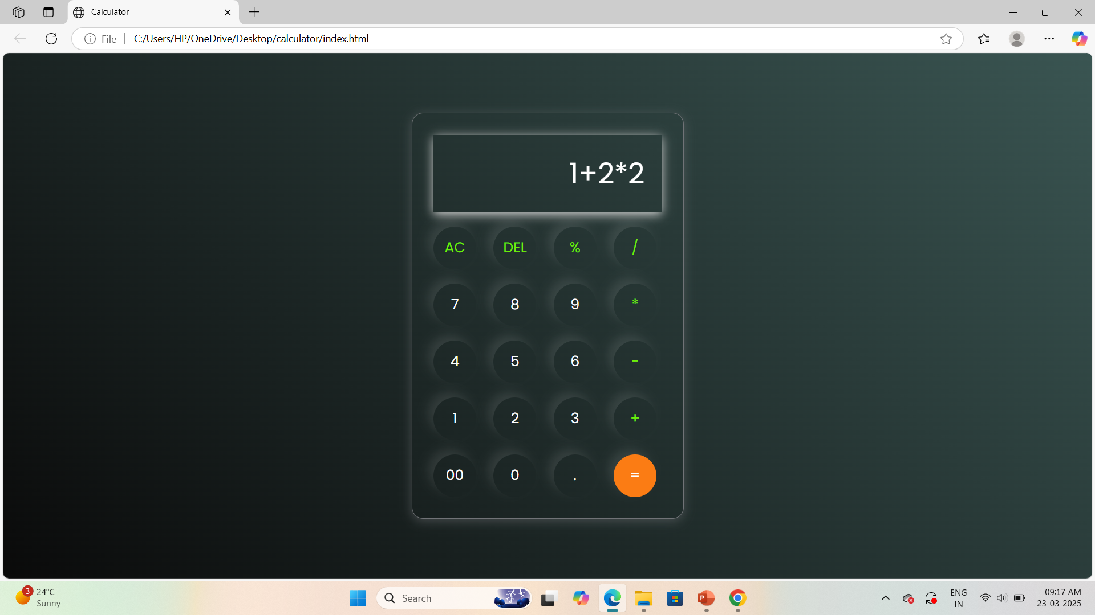
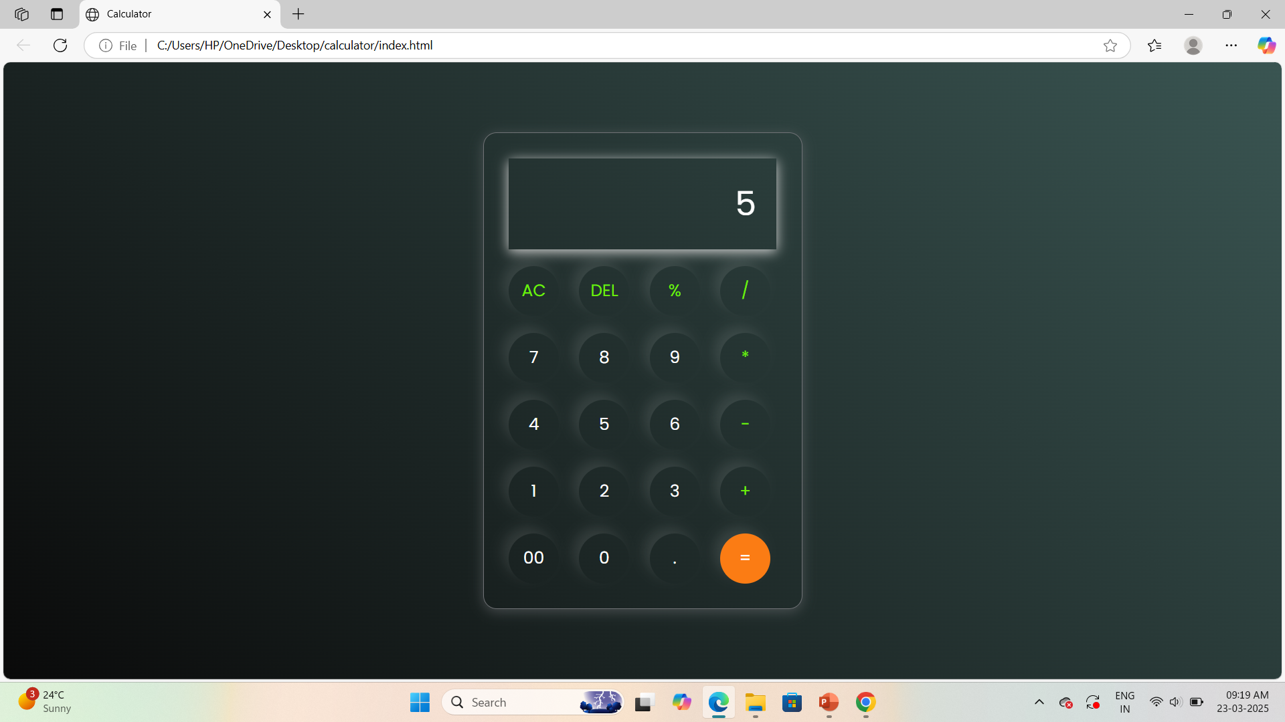
Results

Slide 9
Personal Portfolio Website(Basic Project)
Introduction
A portfolio website serves as a personal online space where individuals showcase their skills, experience, and projects. It is essential for professionals like developers, designers, and freelancers who want to create an impactful online presence. This portfolio website provides information about the individual, their projects, and contact details in a structured and visually appealing manner.

Slide 10
Problem Statement
The main goal of this project is to develop a portfolio website that effectively highlights an individual’s skills, projects, and contact information. The website should be:
User-friendly – Easy navigation across different sections like Home, About, Projects, and Contact.
Visually appealing – A modern design that engages visitors.
Responsive – Optimized for different screen sizes (mobile, tablet, desktop).
Interactive – Includes dynamic elements such as buttons and animations to enhance the user experience.
Informative – Clearly presents personal details, projects, and a contact form for communication.

Slide 11
Techniques used to Solve Problem
HTML for Structure
HTML is used to create the layout of the website, including sections such as Home, About, Projects, and Contact.
The <nav>, <section>, <div>, <ul> and <footer> tags are used for structuring content.
CSS for Styling
CSS enhances the appearance of the portfolio with styles for fonts, colors, spacing, and layout.
Responsive design techniques, such as media queries, are applied for a mobile-friendly experience.

Slide 12
JavaScript for Interactivity
JavaScript is used to add dynamic functionality, such as animations and event handling for buttons.
A script handles form submissions and navigation effects.
Font Awesome for Icons
Icons from Font Awesome are used to visually represent contact details and navigation elements.
Responsive Web Design
The website is designed to adapt to various devices using CSS Flexbox, Grid, and Media
Queries to ensure a seamless user experience.

Slide 13
To Do List(Basic Project)
Introduction
A To-Do App is a simple task management application that helps users organize and track their daily tasks. It allows users to add, update, and remove tasks efficiently. The purpose of this project is to create an interactive and user-friendly to-do list where users can keep track of their pending and completed tasks. This application enhances productivity by providing a structured way to manage tasks with a progress tracker.

Slide 14
Problem Statement
Managing daily tasks can be challenging, especially when there are multiple responsibilities to handle. People often forget important tasks or struggle with prioritization. The objective of this To-Do App is to provide a simple and efficient solution to help users:
Add new tasks easily.
Track progress with a progress bar.
Display the number of completed and total tasks.
Remove completed tasks when necessary.
Provide a clean and intuitive interface for ease of use.

Slide 15
Techniques Used to Solve the Problem
HTML for Structure
HTML provides the basic framework of the application.
It includes an input field to add new tasks, a button to submit tasks, and a task list (<ul>) to display them.
A progress bar and task counter are added to give users a visual representation of their task completion.
CSS for Styling
CSS is used to design an aesthetically pleasing interface.
It styles the input field, buttons, task list, and progress bar for a clean and modern look.
Responsive design techniques ensure that the app looks good on different screen sizes.

Slide 16
3.JavaScript for Functionality
JavaScript enables interactivity by handling user actions such as adding, deleting, and updating tasks.
The click event is used to capture user input when they add tasks.
The progress bar updates dynamically as tasks are completed.
Task count (0/0) is updated in real-time as tasks are added or removed.
The localStorage API can be used to store tasks, ensuring data persistence even after page refresh.
4.Event Handling
JavaScript event listeners detect user interactions, such as clicking the "+" button to add tasks.
Clicking on a task may mark it as completed, triggering an update in the task count and progress bar.

Slide 17
DOM Manipulation
The task list updates dynamically using document.createElement() and appendChild().
Completed tasks may have different styles (e.g., strikethrough text) using CSS class toggling.
Removing tasks updates the total task count and progress percentage in real-time.
By implementing these techniques, the To-Do App provides a seamless experience for users to
manage their daily tasks efficiently.

Slide 18
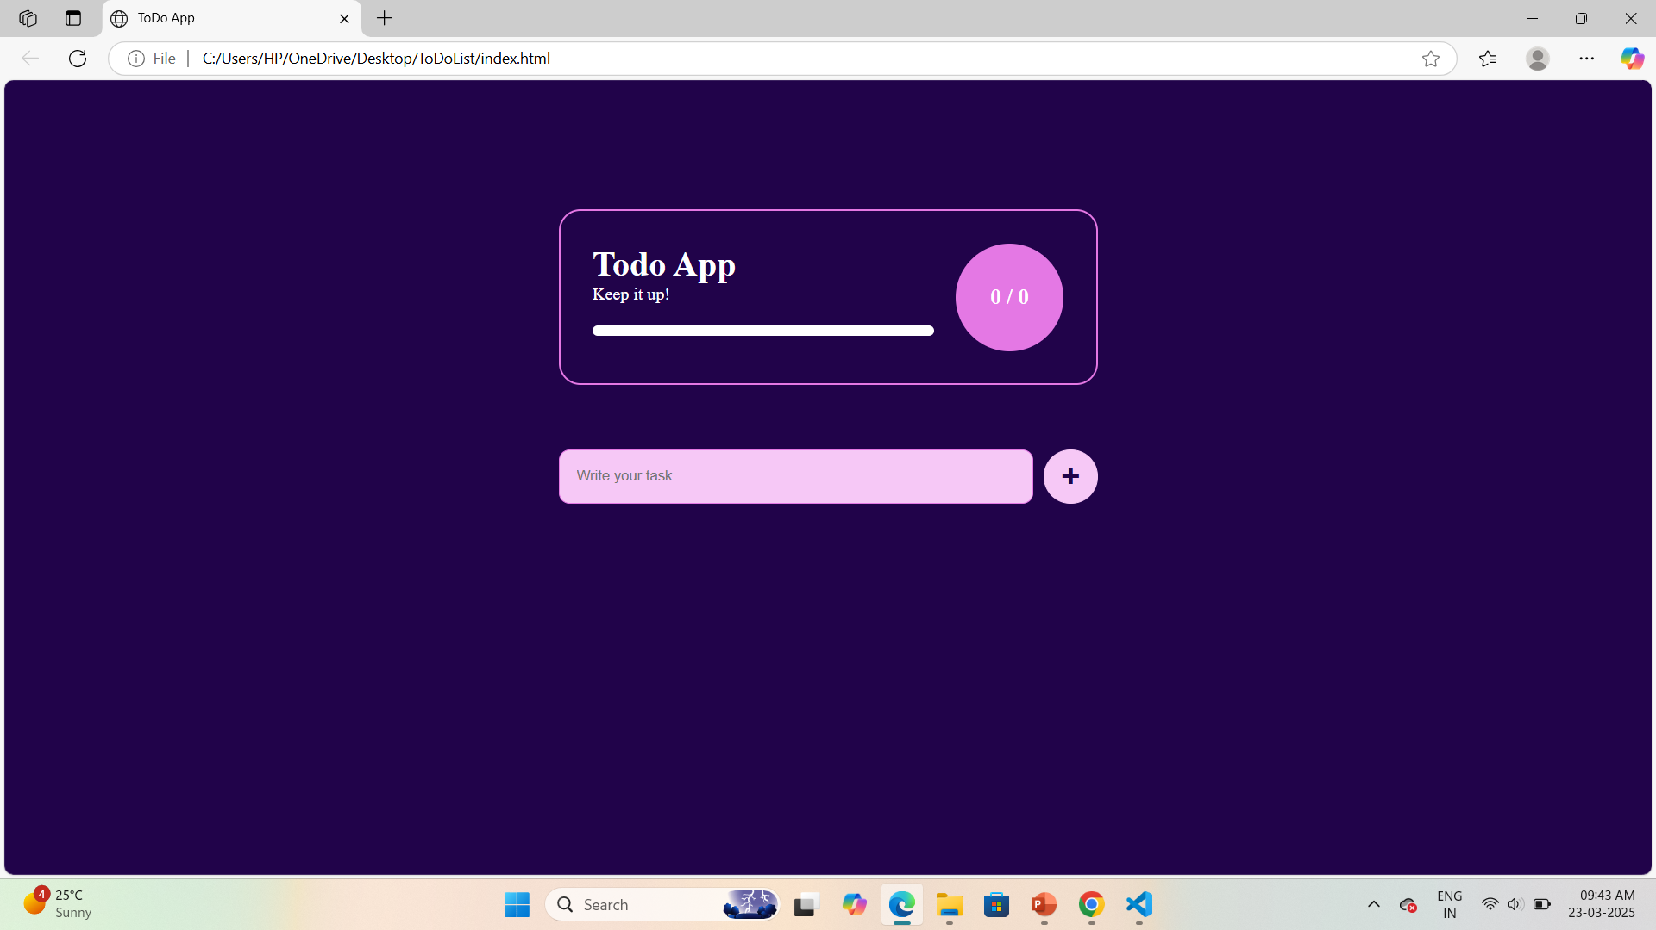
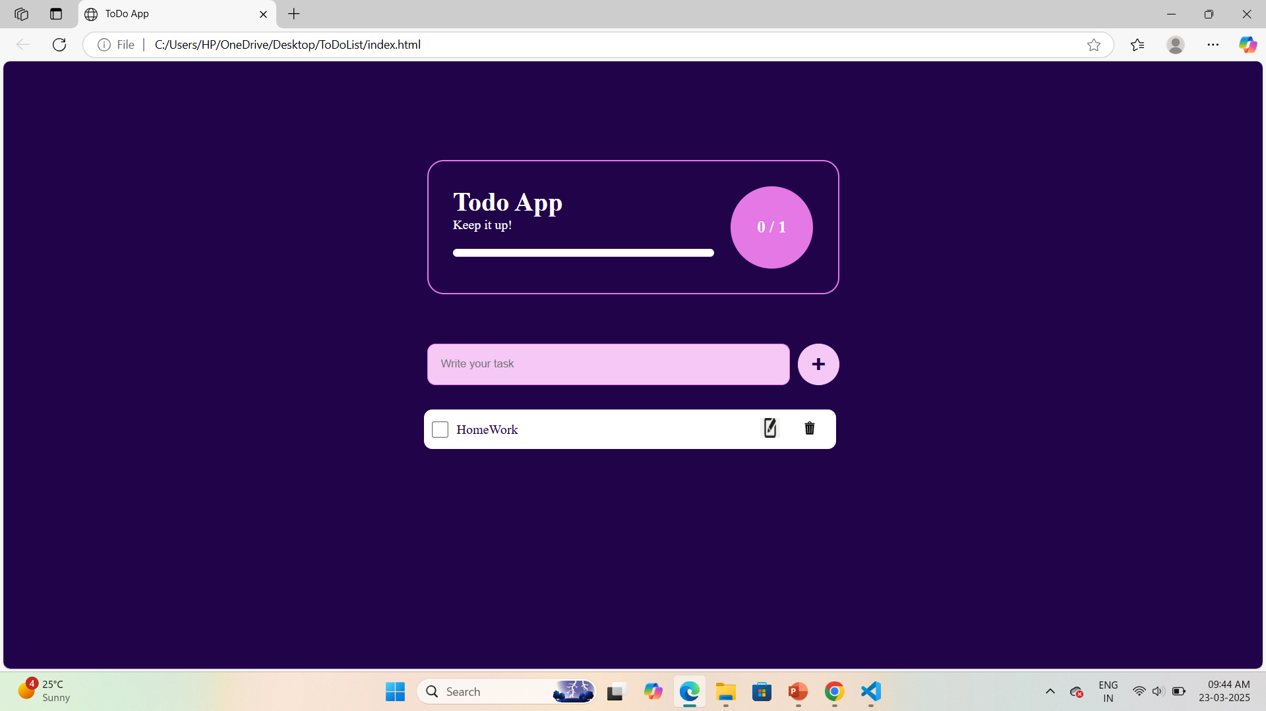
Results

Slide 19
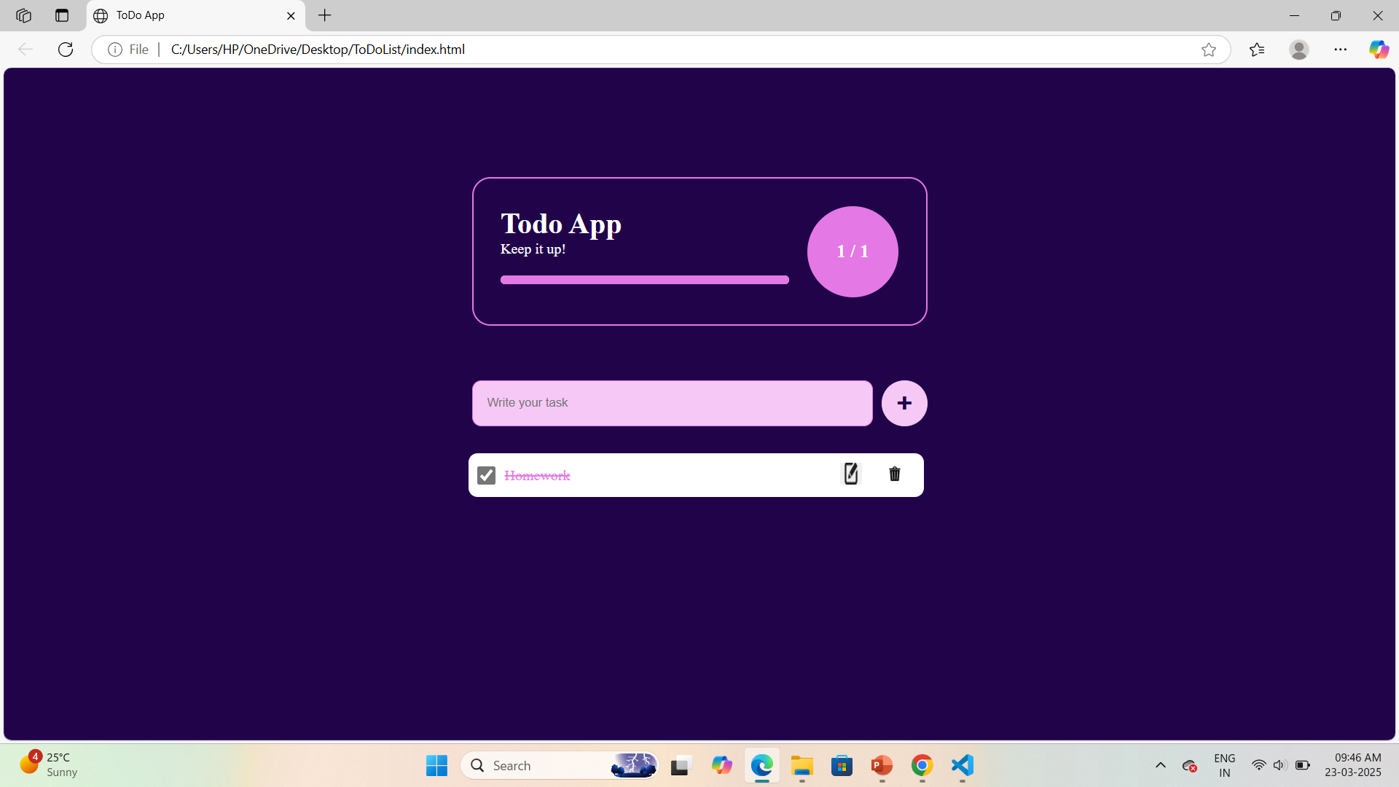

Slide 20
Image Slider(Basic Project)
Introduction
An image slider is a web component used to display multiple images in a slideshow format. It enhances user experience by presenting images in a visually appealing and interactive way. Image sliders are commonly used in websites for showcasing products, galleries, or featured content. This program implements a simple image slider with navigation controls that allow users to move between images manually or play an automatic slideshow.

Slide 21
Problem Statement
The objective of this project is to develop an image slider that:
Displays multiple images in a structured manner.
Allows users to navigate through images using previous ( < ) and next ( > ) buttons.
Provides a play button to automate the image transitions.
Ensures smooth and visually appealing transitions between images.
Improves user engagement by making the slider interactive and responsive.

Slide 22
Techniques Used to Solve the Problem
HTML for Structure
Defines the layout of the image slider using a container (.slider-container).
Uses <img> tags to display images in a sequence.
Includes navigation buttons (prev, play, and next) for user interaction.
CSS for Styling
Styles the slider for a clean and responsive design.
Uses .active class to highlight the currently displayed image.
Applies transitions for smooth effects when switching images.

Slide 23
3.JavaScript for Functionality
Controls image transitions when users click next or previous buttons.
Implements the play button to automate image changes at a fixed interval.
Uses an array or node list to track the images and update their visibility.
Adds event listeners to detect button clicks and change the active image accordingly.
4.Event Handling
Detects user interactions through button clicks and updates the slider accordingly.
Uses JavaScript functions to change the active class dynamically.

Slide 24
5.SetInterval for Automatic Slideshow
Uses setInterval() to cycle through images automatically when the play button is clicked.
Allows stopping the slideshow when needed.
These techniques ensure an interactive and responsive image slider that improves user experience.

Slide 25
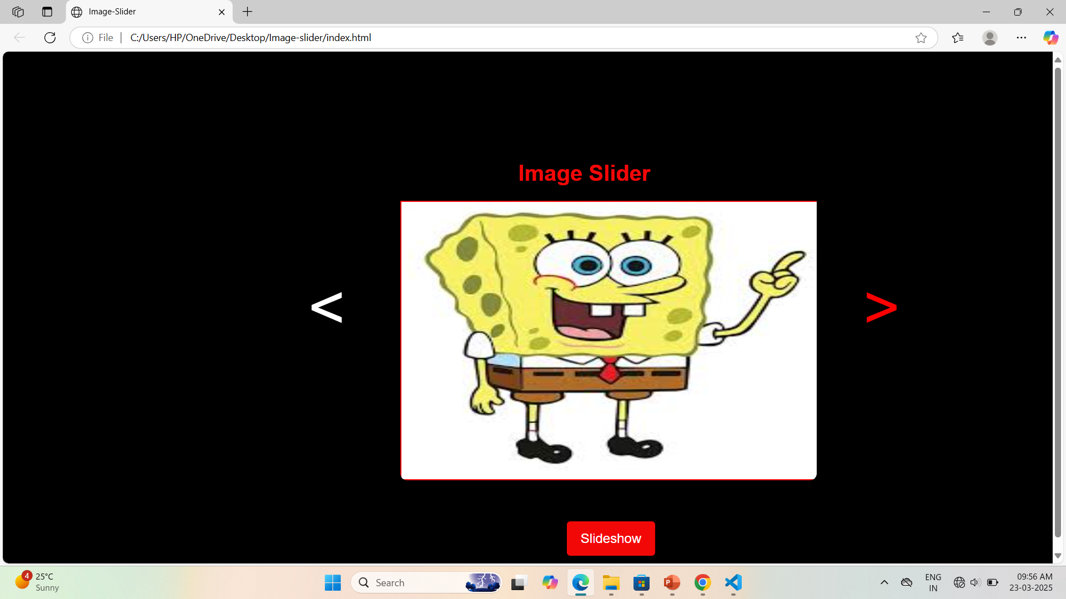
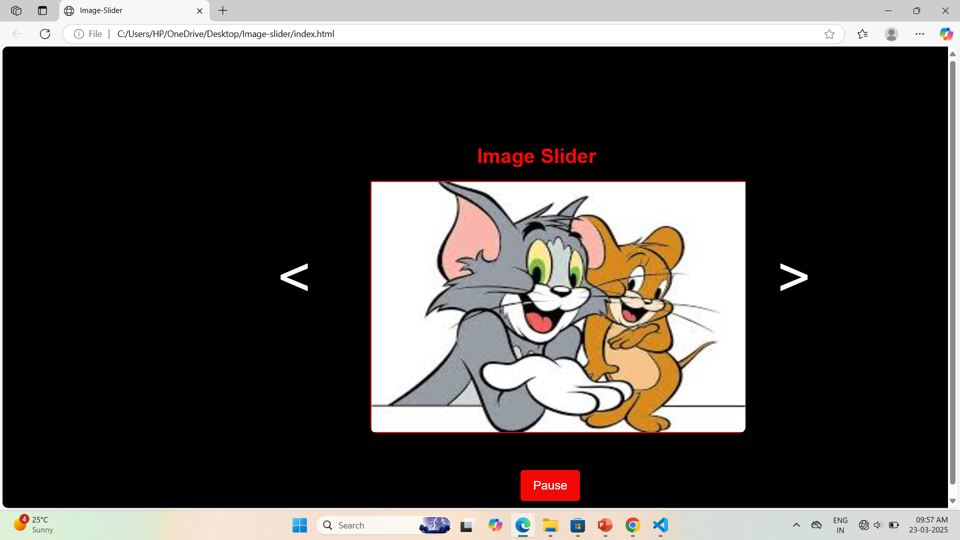
Result

Slide 26
Gym Management System(adv. Project)
Introduction
A Gym Management System is a web-based application designed to streamline and automate the operations of a gym. The system allows gym owners to manage members, track attendance, process payments, and monitor fitness progress efficiently. It eliminates manual paperwork and enhances the overall user experience for both administrators and gym members.
Objectives
Simplify membership registration and management.
Enable attendance tracking using login/logout.
Allow payment tracking for membership fees.
Provide workout and diet plans for members.
Ensure secure authentication and data storage using Firebase.

Slide 27
Problem Statement
Gyms often face challenges in managing memberships, tracking attendance, and maintaining payment records. The traditional manual system is inefficient and prone to errors. The goal of this project is to develop an automated Gym Management System that provides an interactive, user-friendly platform to handle all operations digitally.
Key Problems:
Manual Registration & Membership Management:
Paper-based or Excel-based records are inefficient and difficult to manage.
Attendance Tracking Issues:
Gym owners need an automated check-in/check-out system.
Payment & Subscription Handling:
Keeping track of membership payments and renewal dates is challenging.
Workout & Diet Plan Distribution:
Trainers need an easy way to share plans with members.
Security & Data Management:
Sensitive data needs a secure database to prevent data loss or unauthorized access.

Slide 28
Techniques to Solve the Problem
1. Frontend Development (User Interface)
HTML for structuring web pages (login page, dashboard, attendance tracking, etc.).
CSS for styling and responsive design (using Bootstrap or Tailwind for a better UI).
JavaScript for interactivity (form validation, attendance logging, etc.).
2. Backend & Database Management
Firebase Authentication:
Google Firebase will be used for user authentication (signup, login, password reset).
Firebase
Store member details, attendance logs, and payment records securely in Firebase
3. User Authentication & Authorization
Implement email/password-based authentication using Firebase.
Allow only gym admins to access payment details and member lists.
Use Firebase Authentication rules to prevent unauthorized access.
4. Attendance Tracking System
Implement a QR Code Scanner (optional) or a simple Check-in/Check-out button.
Log timestamps Firebase to track attendance records.

Slide 29
6. Workout & Diet Plan Management
Gym trainers can upload custom workout plans and diets for members.
Plans are stored Firebase and accessible via the member’s dashboard.
7. Responsive & Mobile-Friendly UI
Use Bootstrap or Tailwind CSS for a clean and mobile-friendly design.

Slide 30
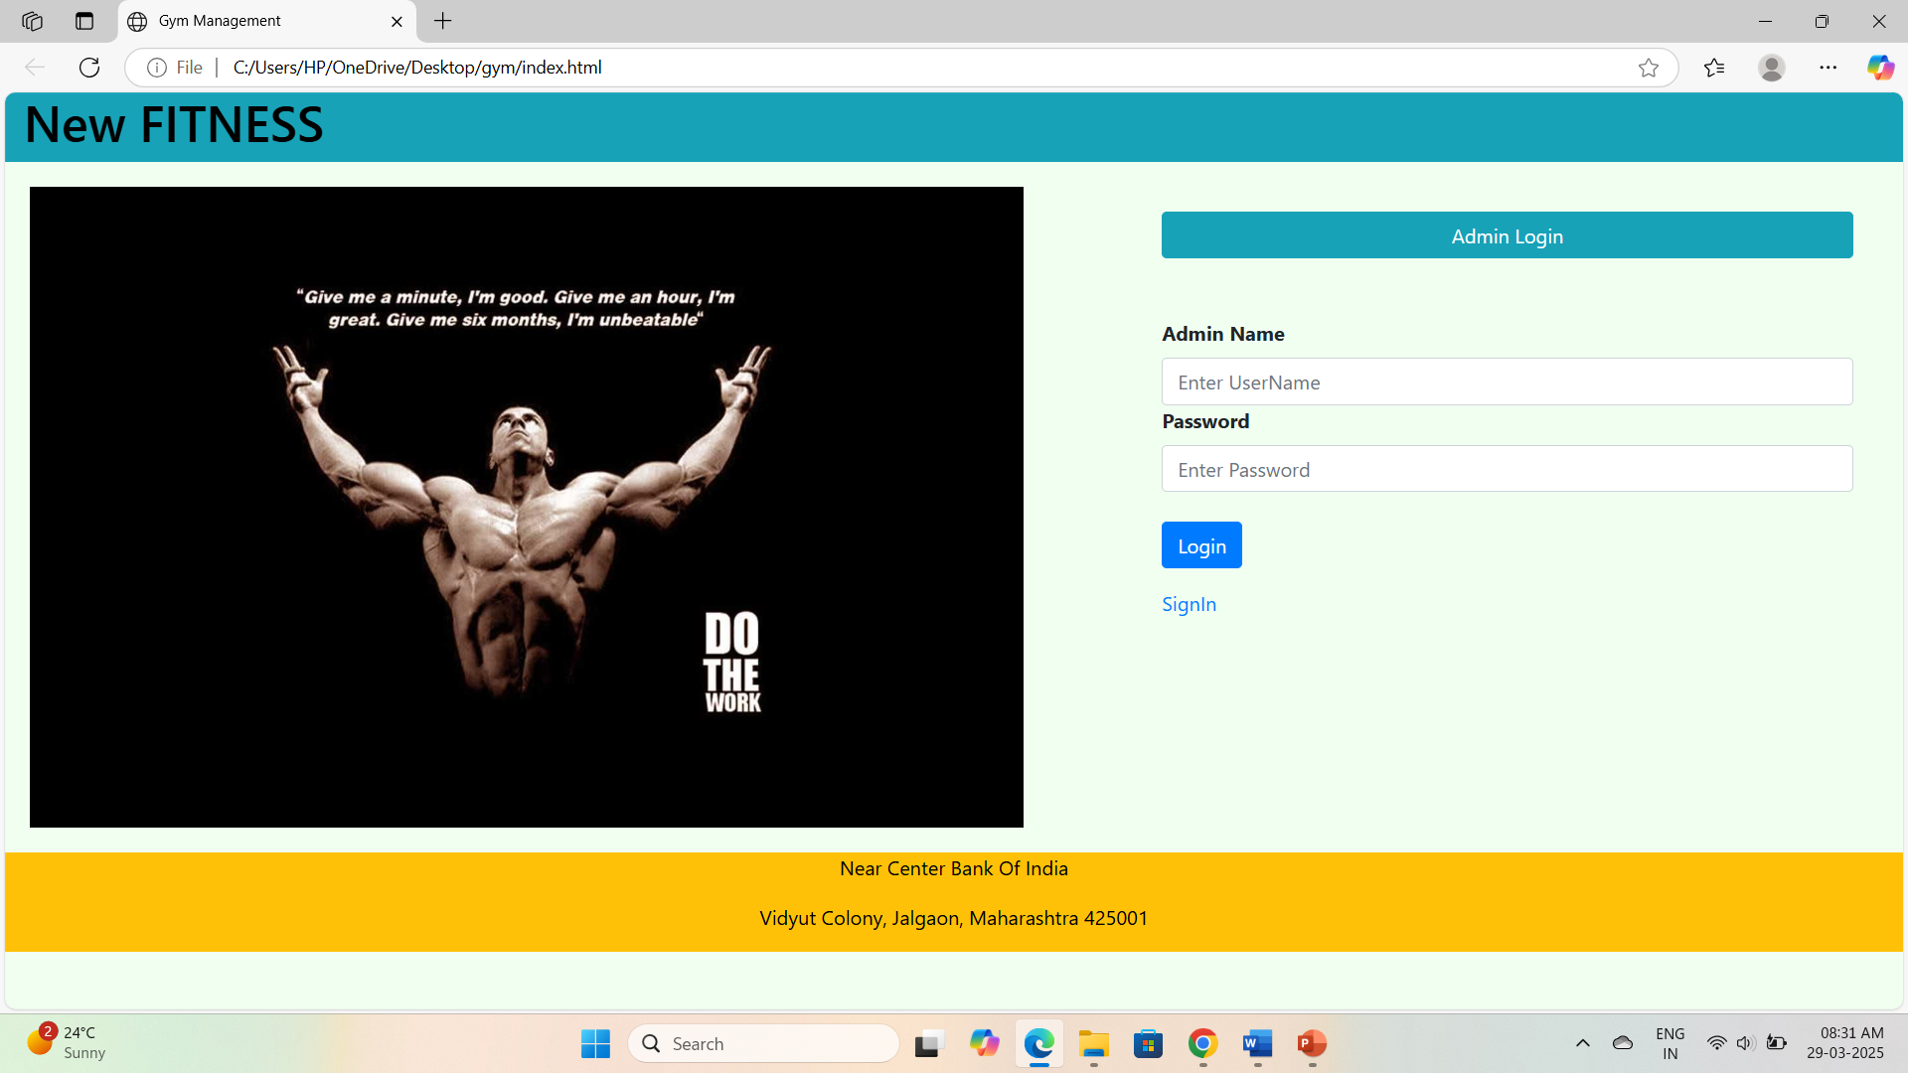
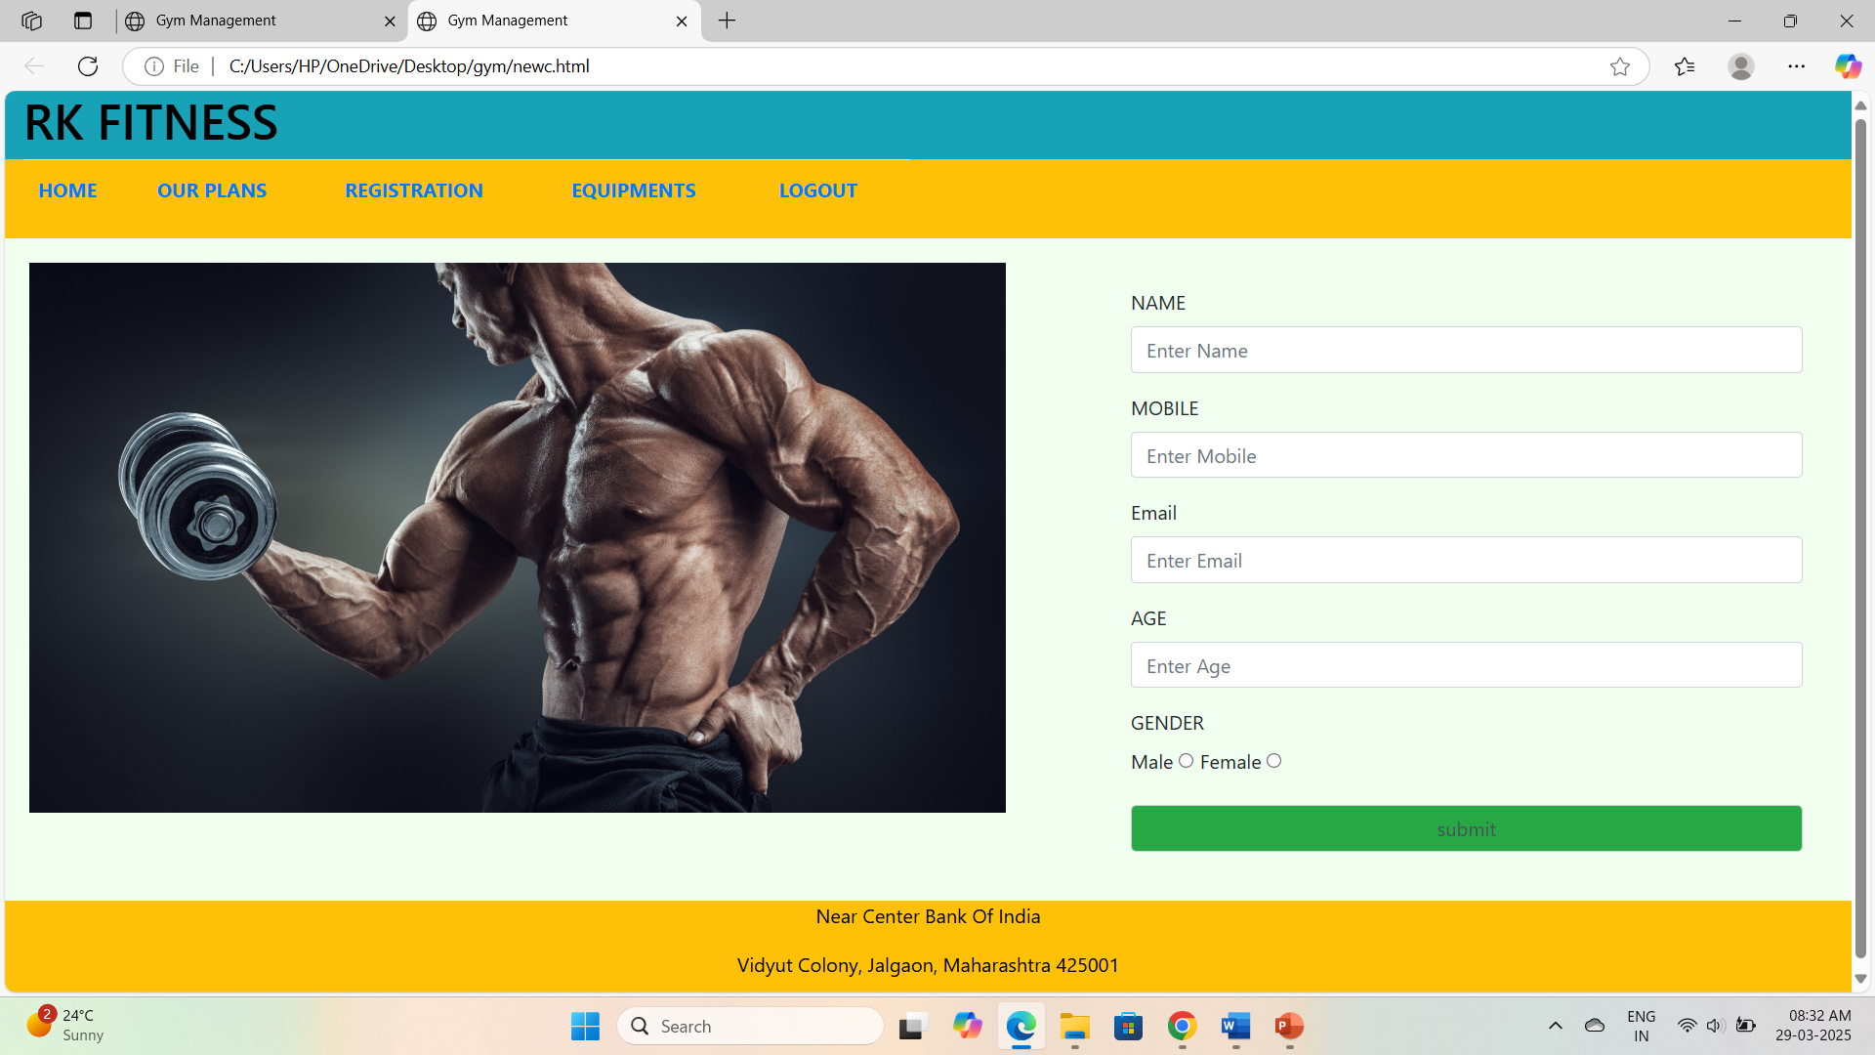
Results

Slide 31
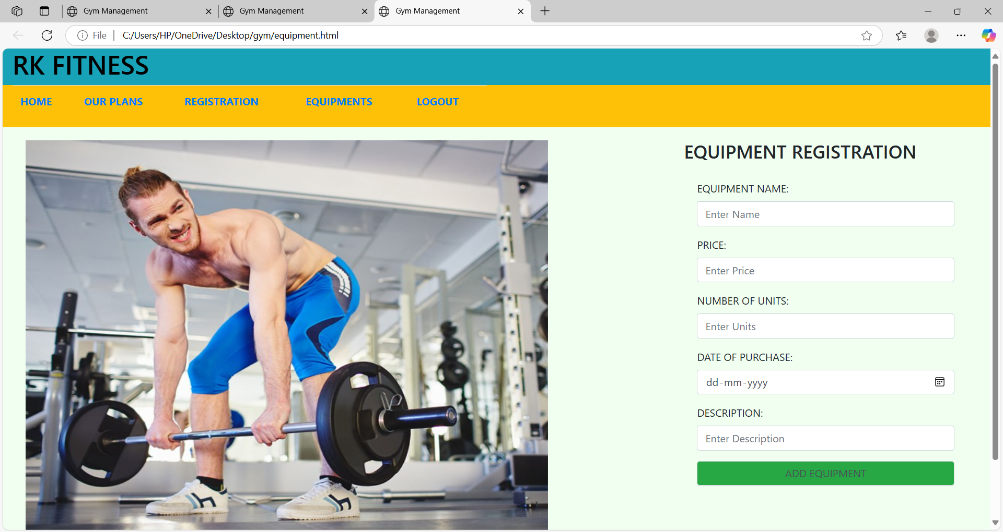
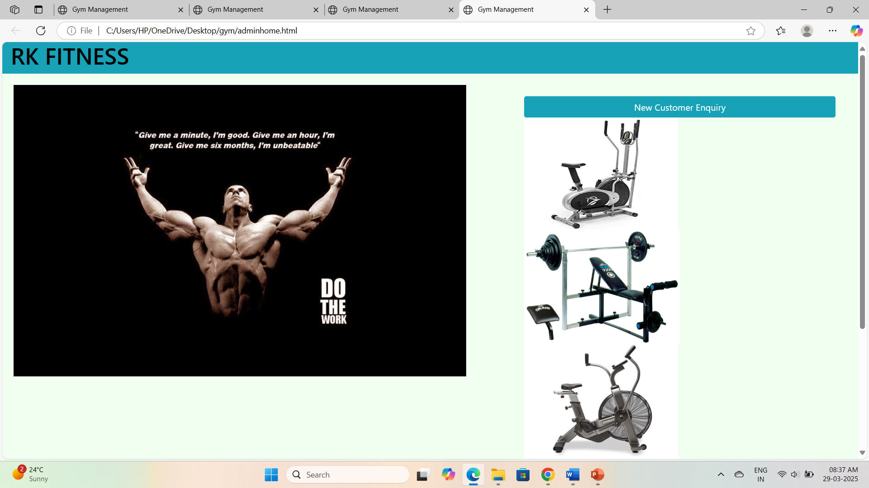

Slide 32
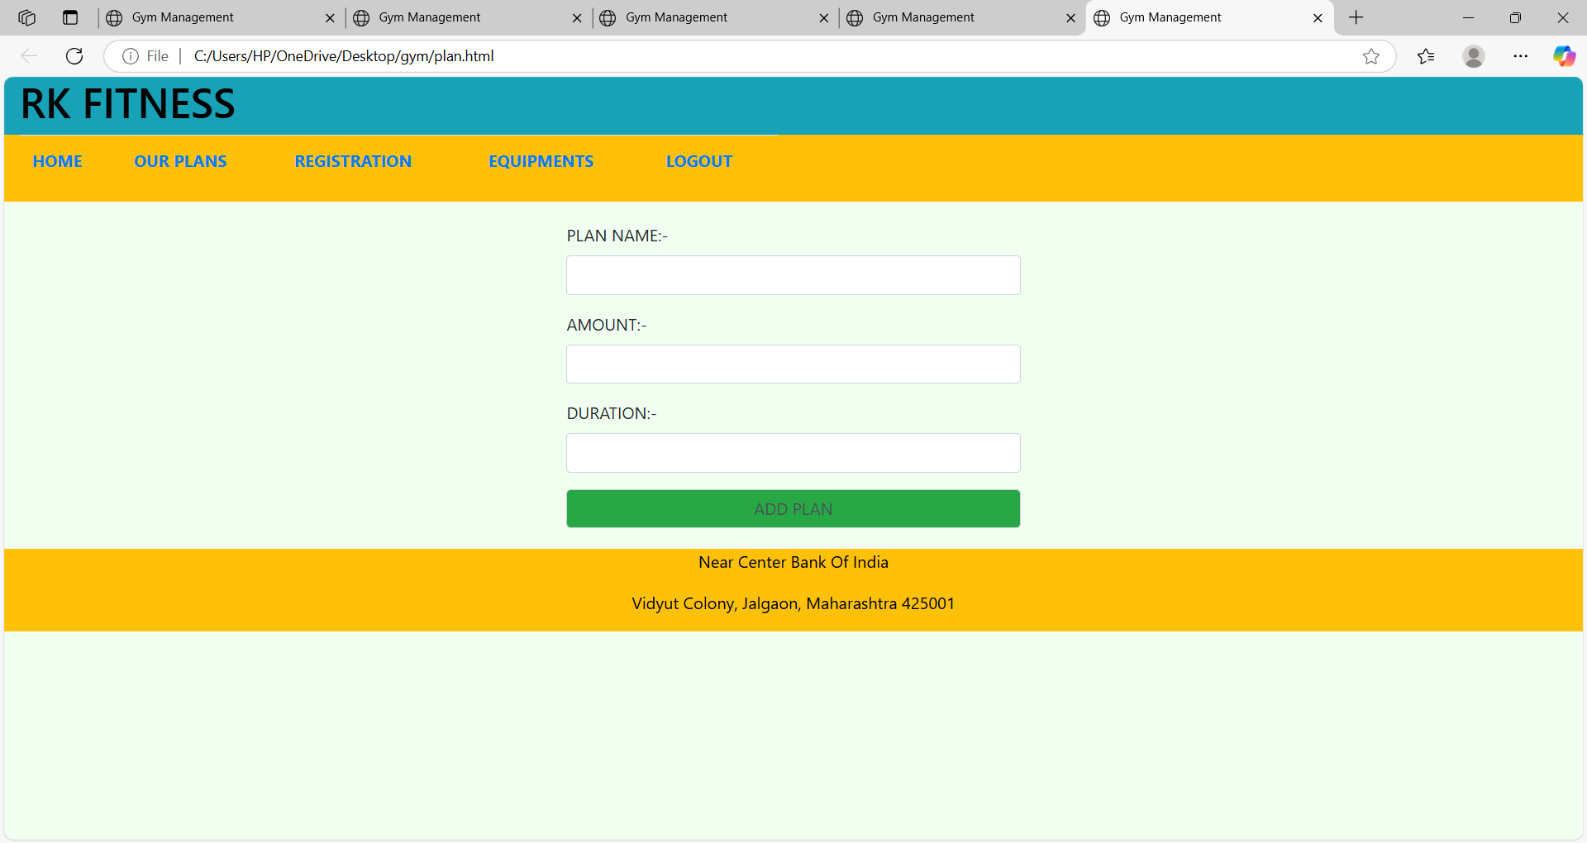
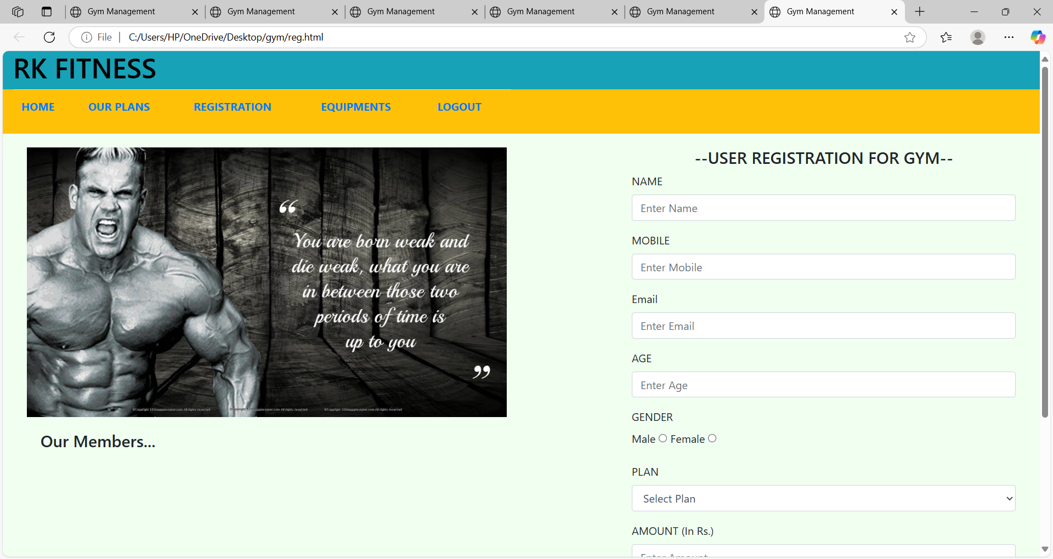

Slide 33
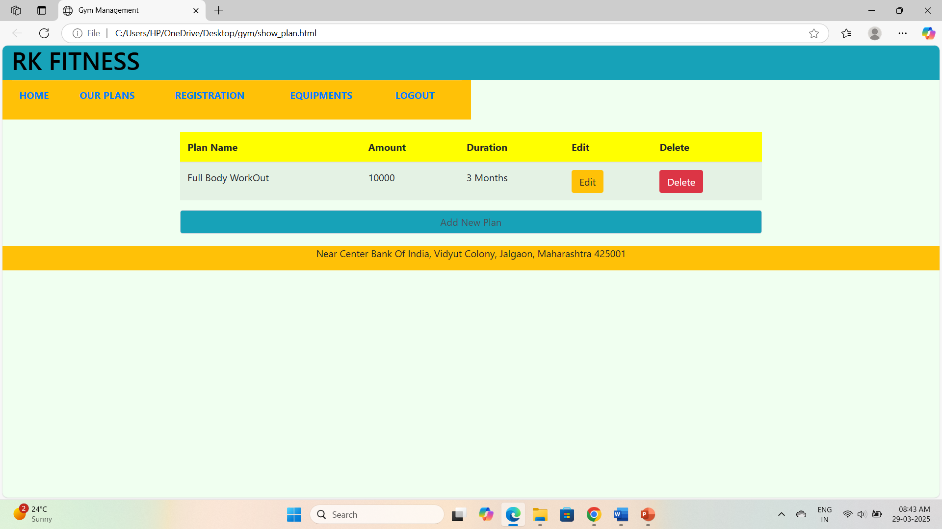
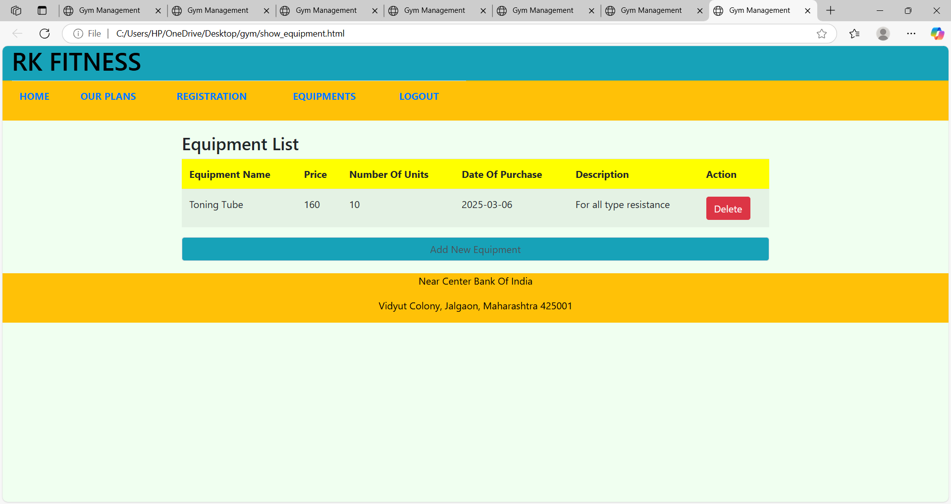

Slide 34
